Slide 1

CUI Abbottabad
Department of Computer Science
SRE
3
RE Types

Slide 2
Outline
Documenting Requirements :
Characteristics
Guidelines
Functional & Non-Functional Requirements

Slide 3
idea
Without a map (or well, Google Maps!), it can get tough traveling to a new city or country. You wouldn’t know what transport to take or which direction to travel in, making it almost impossible to reach your destination.
Similarly, in software development, you are highly unlikely to create the right product without proper documentation of software requirements.
Documentation ensures that the software development team or other stakeholders are on the same page regarding what needs to be built and are fully aware of the goal, scope, functional requirements, challenges, and budget regarding the software. However, as much as creating software is exciting, documenting its requirements can be boring and tiresome.

Slide 4
These documents are often long, text-heavy, and full of technical jargon, making them very difficult to understand. This makes them highly vulnerable to misinterpretations and can thus, lead to disastrous results.
To avoid costly design mistakes, product managers and software developers often use pre-made templates that keep the documentation process to the point and easy to understand

Slide 5
What is a Software Requirements Document? – Definition
A software requirements document (also known as software requirements specifications) is a document that describes the intended use-case, features, and challenges of a software application.
These documents are created before the project has started development in order to get every stakeholder on the same page regarding the software’s functionality
Software requirements are written up by the tech team depending on the project they are working on. As non-technical colleagues, clients, and partners get involved it’s important to ensure that everyone is on the same page and agree with the scope, budget, and goal of the project

Slide 6
Why a Software Requirements Document is Important?
Software requirement documents provide an important map of the product being built, the features that will be included, and much more.
This roadmap helps to keep the technical and non-technical team on the same wavelength as to what the expectations are. It helps to ensure that the product is built meeting the needs whether it’s for internal purposes, for users or clients.

Slide 7
What You Should Include in Your Software Requirements Document?
A typical software requirements document should involve the following details:
1. Introduction
1.1 Purpose: Set the expectations for the outcome of the product.
1.2 Intended Audience: Who is the software for? Who is the end-user? Will the software be used internally at a company or externally?
1.3 Intended Use: What is the software for? What problem is it solving?
1.4 Scope: Explain the scope of the software. What are the main goals and objectives? How do they relate to the company’s goals?
1.5 Definitions and Acronyms: Provide an overview of any definitions the reader should understand before reading on.

Slide 8
2. Overall Description: Describe what you are building and for who.
2.1 User Needs: Explain the user needs for this software.
2.2 Assumptions and Dependencies: What assumptions are you making that could cause an error in your approach? Is the project reliant on any other factors that could affect the development of the software?
3. System Features and Requirements
3.1 Functional Requirements: Take time to define the functional requirements that are essential for the software to build.
3.2 External Interface Requirements: Are there any UX and UI requirements that you must keep in mind as you build?
3.3 System Features: What features are required for the software to even work.
3.4 Nonfunctional Requirements: Are there any non-functional requirements that you need to address (i.e. budget, team, etc.)
https://blog.bit.ai/process-documentation-guide/
https://blog.bit.ai/software-requirements-document/

Slide 9
Tools for documentation
Bit.ai
ProProfs Knowledge Base
GitHub
MarkdownPad
Read the Docs
Doxygen
https://blog.bit.ai/software-documentation-tools/

Slide 10
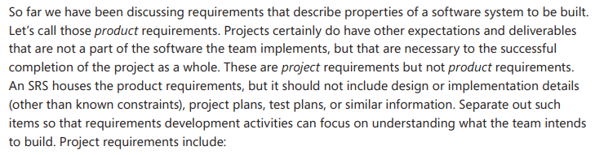
Project vs product requirements

Slide 11
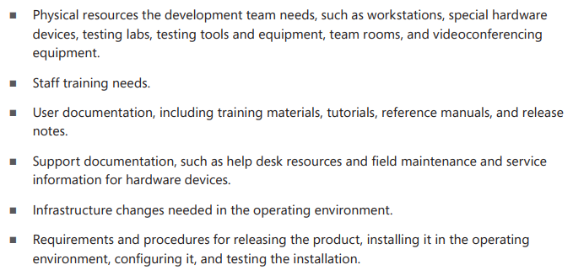

Slide 12
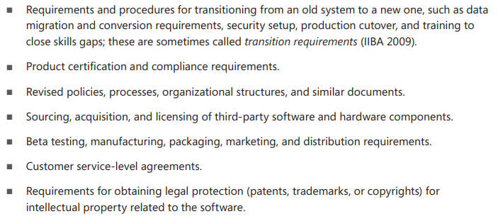

Slide 13
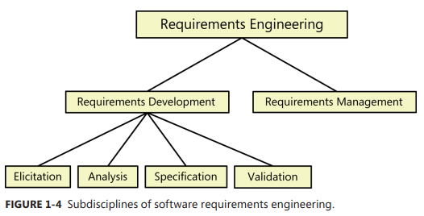
Requirements development and management

Slide 14
Requirements development We subdivide requirements development into elicitation, analysis, specification, and validation . These subdisciplines encompass all the activities involved with exploring, evaluating, documenting, and confirming the requirements for a product. Following are the essential actions in each subdiscipline.

Slide 15
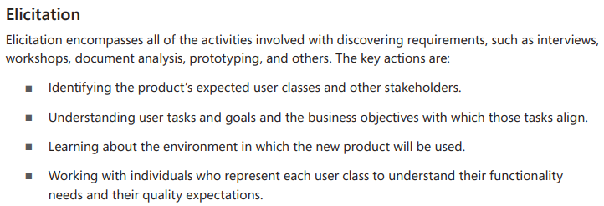

Slide 16
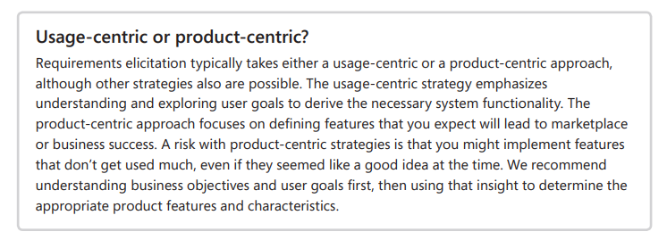

Slide 17
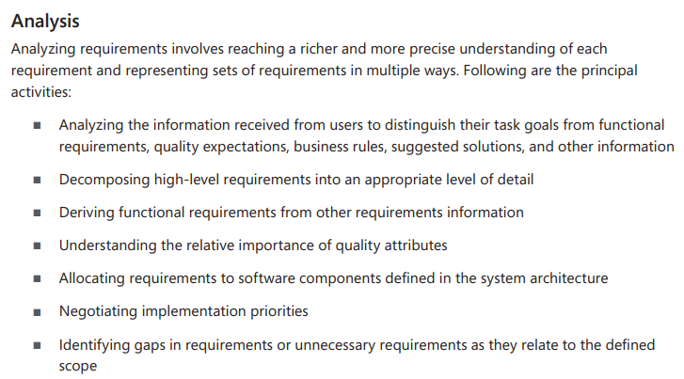

Slide 18
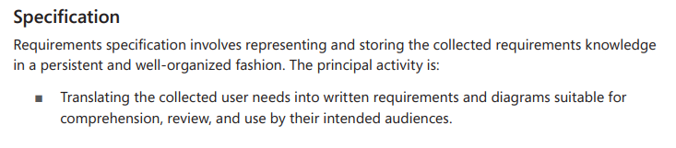

Slide 19
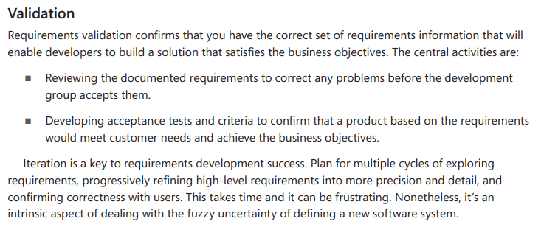

Slide 20
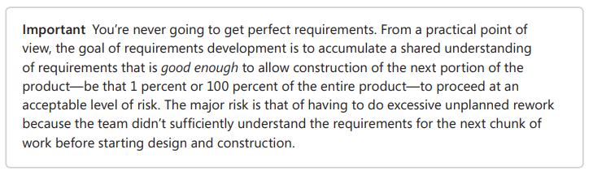

Slide 21
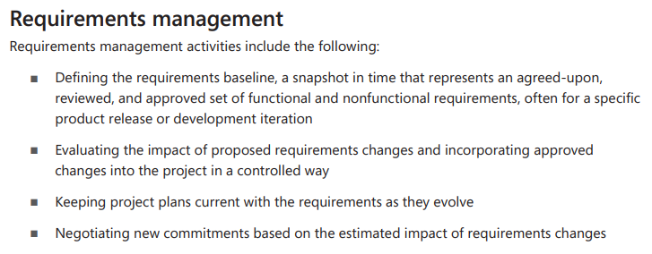

Slide 22
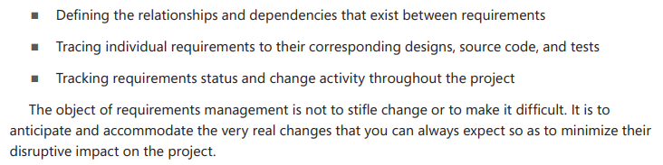

Slide 23
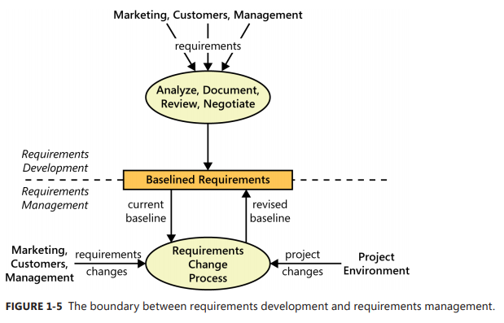

Slide 24
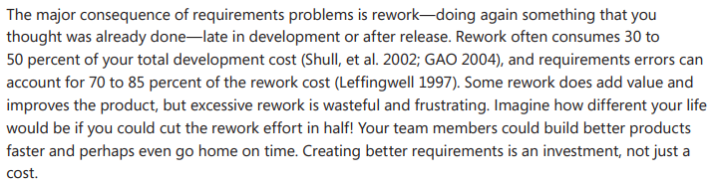
When bad requirements happen to good people

Slide 25
It can cost far more to correct a defect that’s found late in the project than to fix it shortly after its creation. Suppose it costs $1 (on a relative scale) to find and fix a requirement defect while you’re still working on the requirements. If you discover that error during design instead, you have to pay the $1 to fix the requirement error, plus another $2 or $3 to redo the design that was based on the incorrect requirement. Suppose, though, that no one finds the error until a user calls with a problem.
Depending on the type of system, the cost to correct a requirement defect found in operation can be $100 or more on this relative scale (Boehm 1981; Grady 1999; Haskins 2004). One of my consulting clients determined that they spent an average of $200 of labor effort to find and fix a defect in their information systems using the quality technique of software inspection, a type of peer review.
In contrast, they spent an average of $4,200 to fix a single defect reported by the user, an amplification factor of 21. Preventing requirements errors and catching them early clearly has a huge leveraging effect on reducing rework.

Slide 26
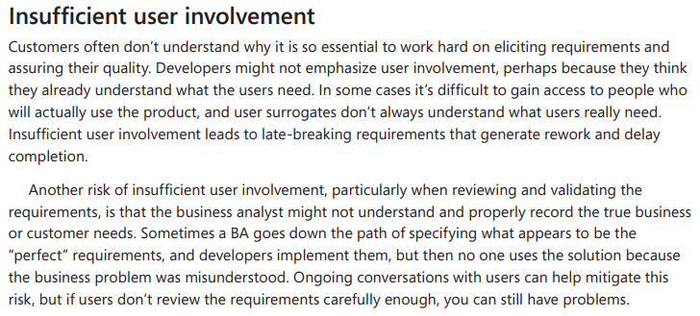

Slide 27
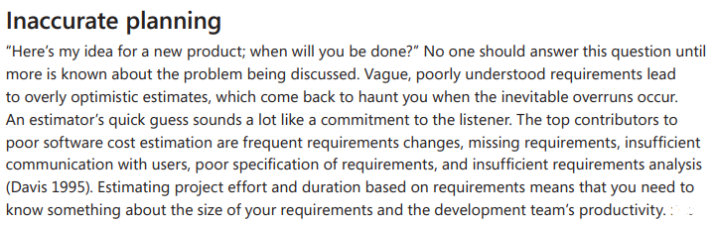

Slide 28
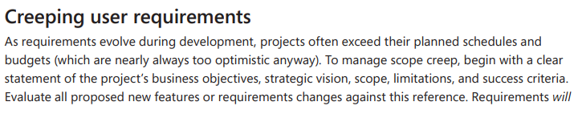
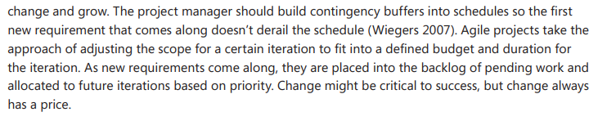

Slide 29
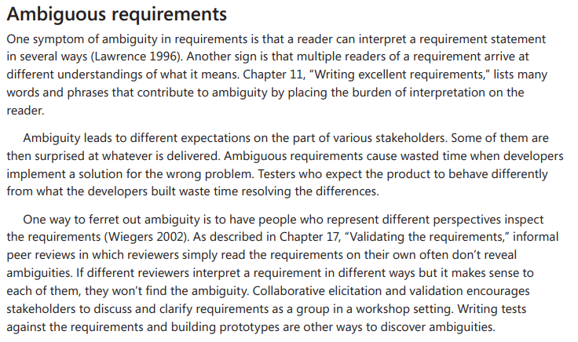

Slide 30
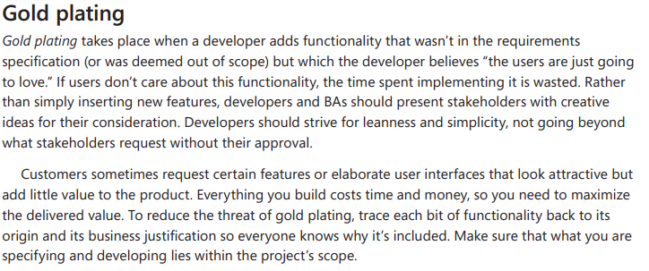

Slide 31
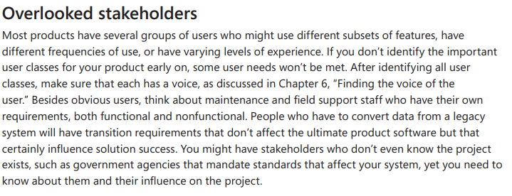

Slide 32
Benefits from a high-quality requirements process
■■ Fewer unnecessary and unused features. ■■ Lower enhancement costs. ■■ Fewer miscommunications. ■■ Reduced scope creep. ■■ Reduced project chaos. ■■ Higher customer and team member satisfaction. ■■ Products that do what they’re supposed to do.

